Slide 1
SAP EWM EXTENDED WAREHOUSE MANAGEMENT TRAINING
AnubhavTrainings.com
www.anubhavtrainings.com

Slide 2

SAP EWM TRAINING
BY:-
Mr. Bijoy
www.anubhavtrainings.com
Notes:
https://unsplash.com/photos/uXB-7la5vqA

Slide 3
SAP EWM TRAINING (Day 08)
AnubhavTrainings.com

Slide 4
Packaging Specification & PPF Actions
Packspec Concept in SAP EWM
Configurations related to Packaging Specification - Level type, Element type & Level set, Maintain Pack spec for Auto Packing
Testing of Packspec
PPF Actions for Automatic Warehouse Tasks, HU Label printing

Slide 5
EWM OUTBOUND PROCESS & WOCR
EWM Outbound Process
Warehouse Process type
Determination of Warehouse process type
Specify Stock removal rule
Storage type search sequence
Stock Removal control indicator
Determination Storage type Search sequence for Stock removal
Optimization of access strategies for Storage type determination in stock removal
Warehouse Order Creation rule (WOCR)
What is WOCR?
Define Filters for Warehouse order creation rules
Define Limit values for the Size of Warehouse order
Define Creation rule for Warehouse orders
Define Search Sequence of creation rules for Activity areas
Test Scenario

Slide 6
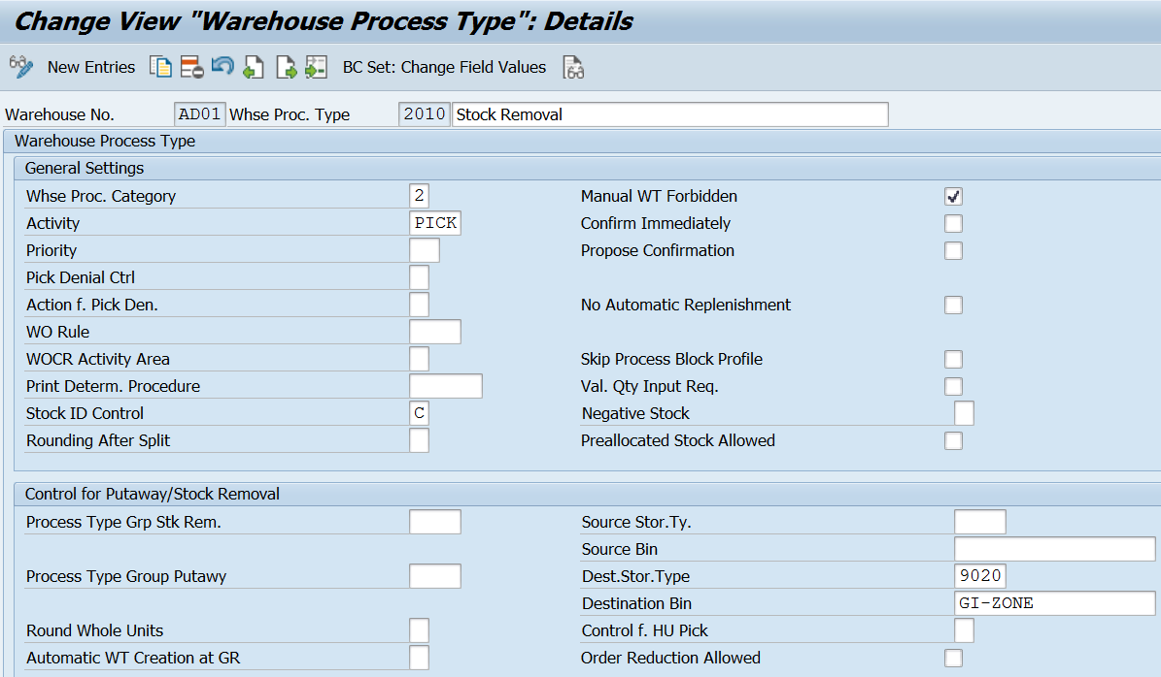
Warehouse Process type

Slide 7
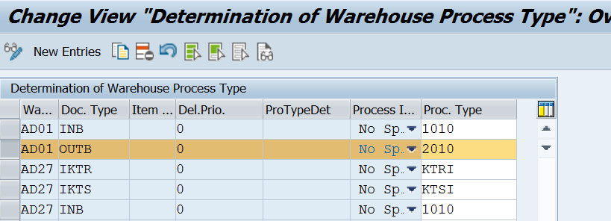
Determination of Warehouse process type
In this Customizing activity, you the configure automatic determination of the warehouse process type.
When Extended Warehouse Management (EWM) creates a warehouse request, it automatically determines the warehouse process type.

Slide 8
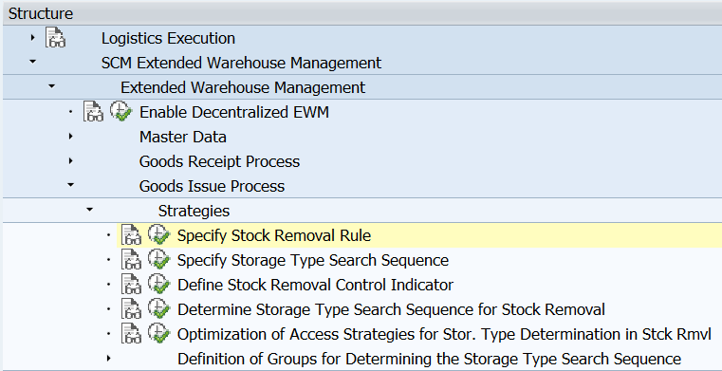
Specify Stock removal rule
The stock removal rule defines the sequence in which the quants found should be sorted.

Slide 9
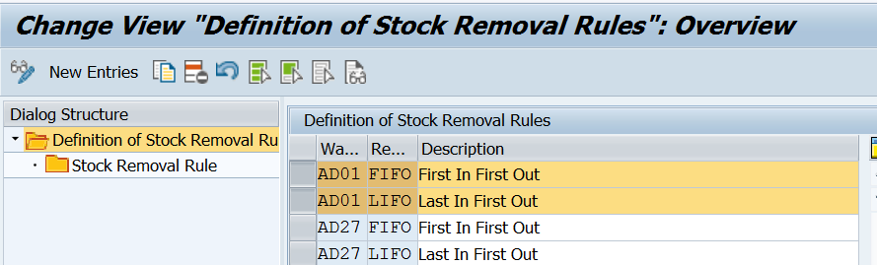
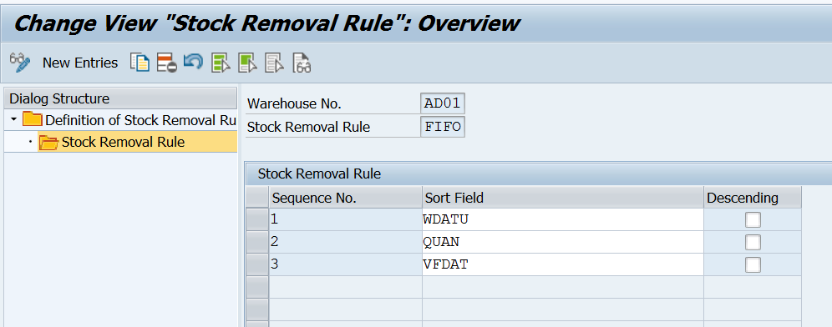

Slide 10
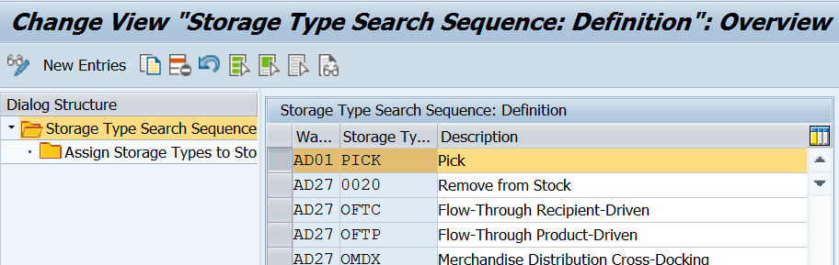
Storage type search sequence
The storage type search sequence contains information concerning the storage types in which the system searches for stock for removal, and in which sequence the stock should be sorted. The sequence of preferred storage types/storage type groups from which the products should be removed, is stored in a preference list

Slide 11
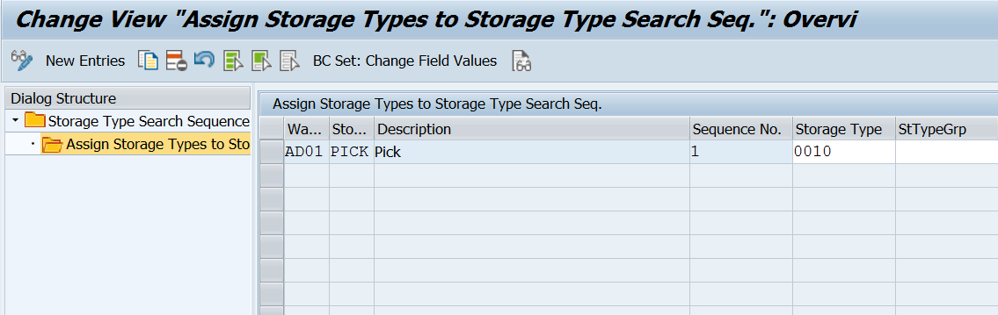

Slide 12
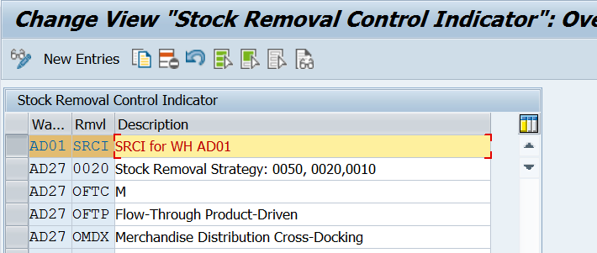
Stock Removal control indicator
This indicator can be assigned in EWM Product master data.
www.anubhavtrainings.com

Slide 13
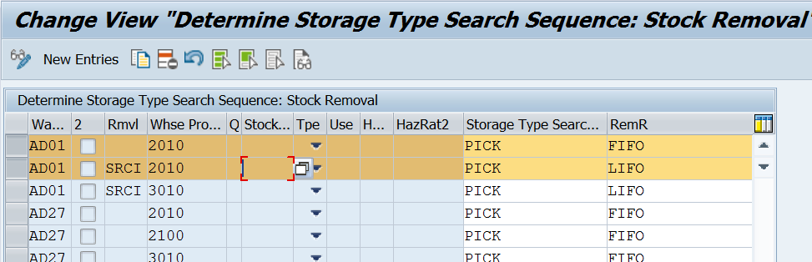
Determination Storage type Search sequence for Stock removal
In this IMG activity, you specify the storage type search for the storage type search sequence during stock removal.
www.anubhavtrainings.com

Slide 14
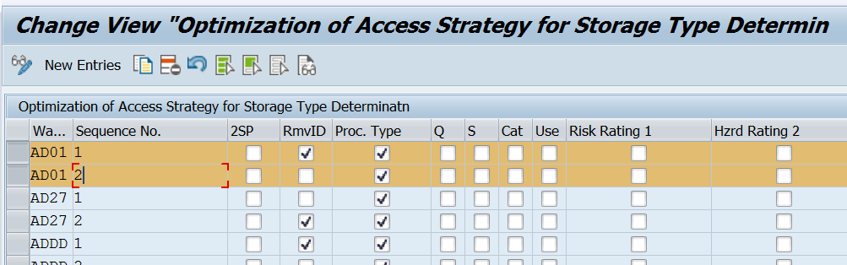
Optimization of access strategies for Storage type determination in stock removal

Slide 15
Warehouse Order Creation rule
The warehouse order (WO) creation rule consists of several attributes that determine how warehouse tasks should be bundled in WOs. This includes filter and limit rules as well as packing profiles.
Use
During warehouse task creation the system can find warehouse order (WO) creation rules in the following ways:
The warehouse process type that is used has a WO creation rule directly assigned to it. In this case the system tries to use this WO creation rule. If a warehouse task does not fulfill the rule's settings, the system uses the default WO creation rule DEF.
If the warehouse process type that is used does not contain a WO creation rule, the system evaluates the activity area of the warehouse tasks and uses the search sequence of creation rules for activity areas. For more information see Define Search Sequence of Creation Rules for Activity Area. In this way, you can specify multiple WO creation rules. The system evaluates the rules in the given sequence. If a warehouse task does not fulfill any of the rules specified, the system uses the remainder rule UNDE.
www.anubhavtrainings.com

Slide 16
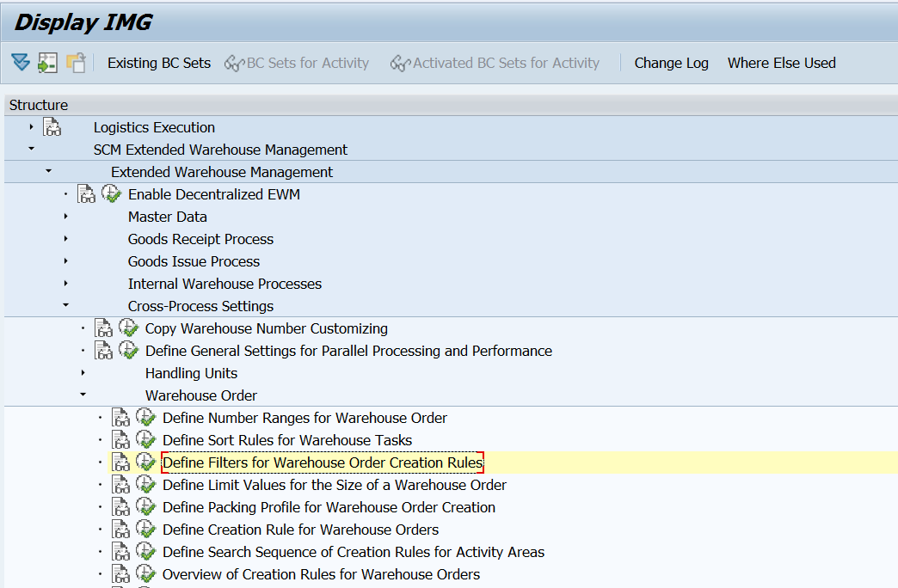
If a WO creation rule is specified in a warehouse process type, then the system uses it even if there is an appropriate entry in the search sequence of creation rules for activity areas.

Slide 17
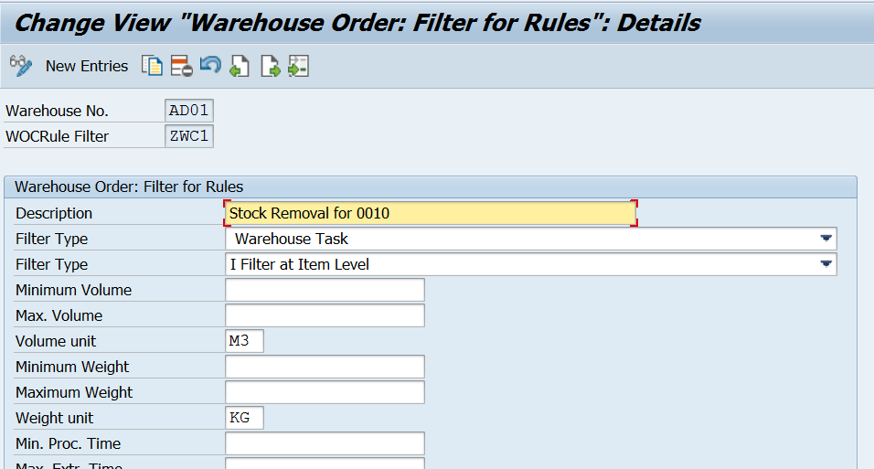
Define Filters for Warehouse order creation rules
Specify whether warehouse order creation uses a rule to process a warehouse task (WT). Warehouse order creation uses the filters on all WTs that you have not yet assigned to a warehouse order, and which it should process.

Slide 18
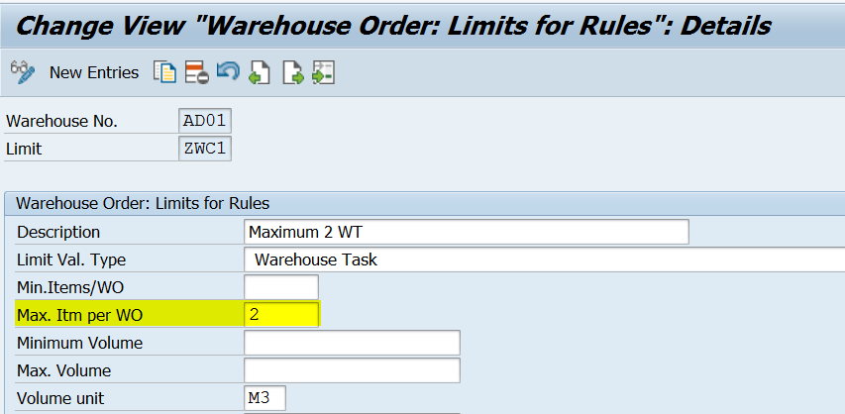
Define Limit values for the Size of Warehouse order
In this Customizing activity, you can define the size of a warehouse order. This means that you restrict the number of items in the warehouse order.

Slide 19
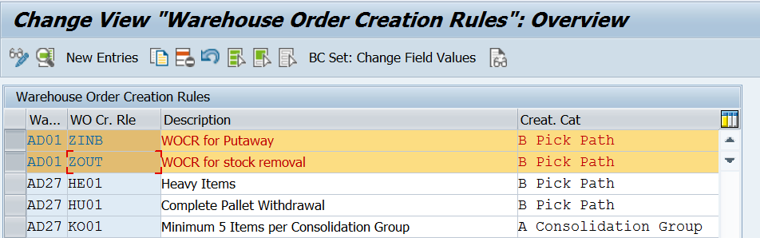
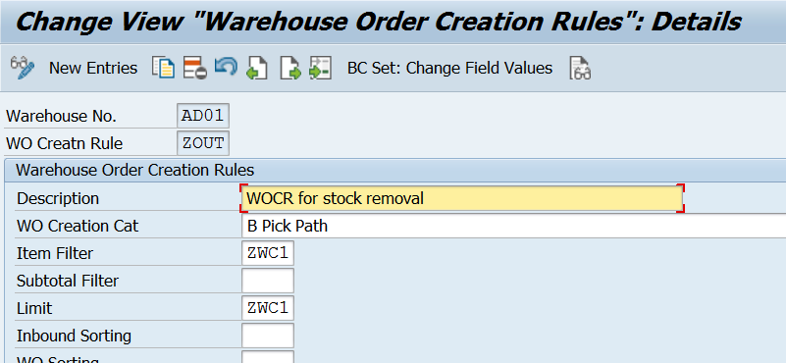
Define Creation rule for Warehouse orders
Create creation rule & assign item filter and limit for rule.

Slide 20
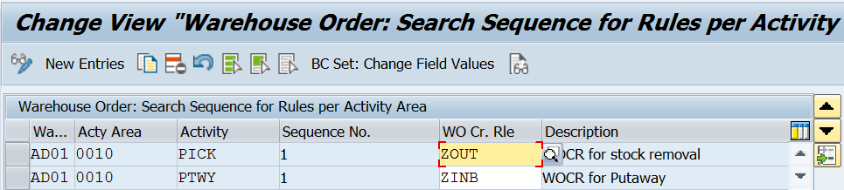
Define Search Sequence of creation rules for Activity areas
In this IMG activity, you define the search sequence of warehouse order creation rule for activity areas.
You can assign one or more warehouse order creation rules to each defined activity area. These rules are processed during warehouse order creation for each activity area, according to the sequence defined.

Slide 21
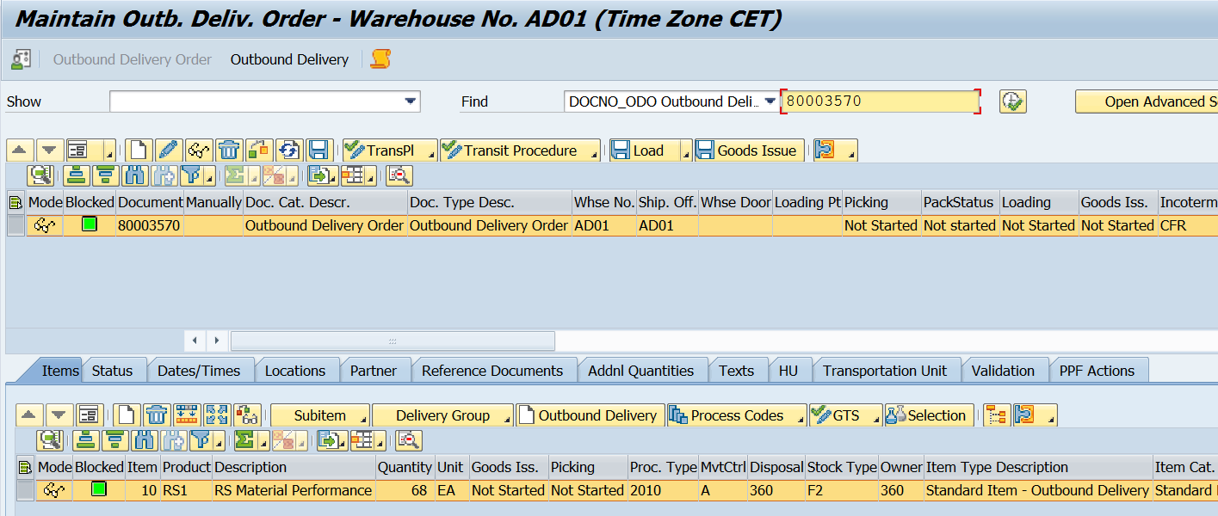
Test Scenario for WOCR

Slide 22
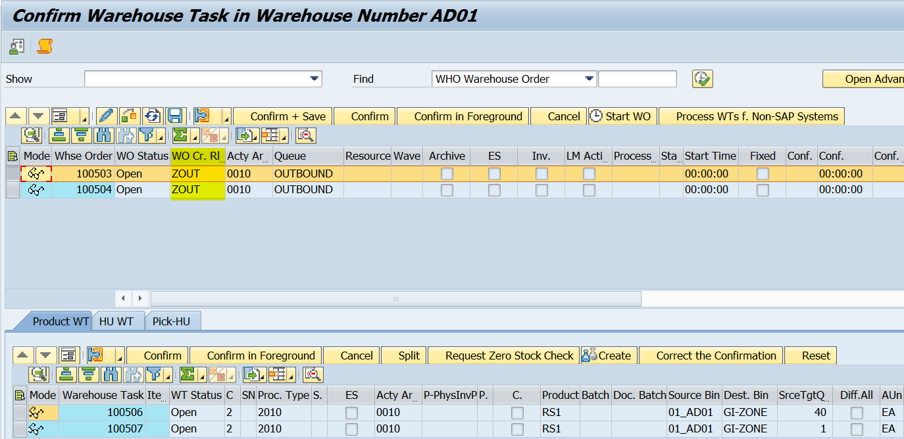
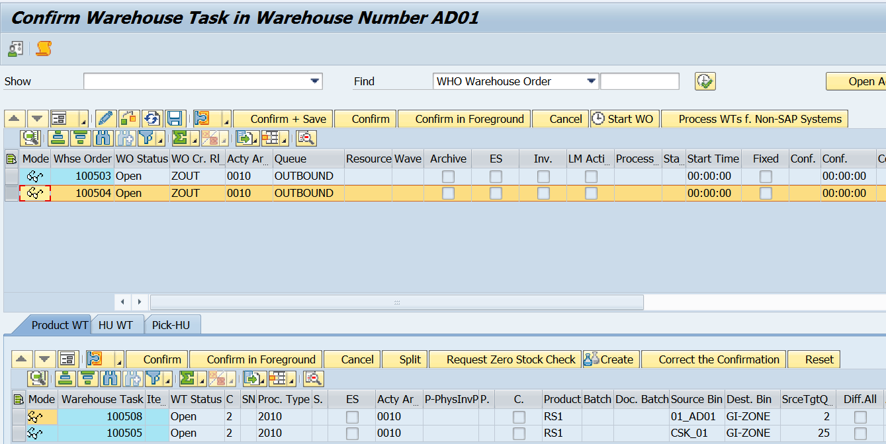
Warehouse tasks are divided as per WOCR.

Slide 23
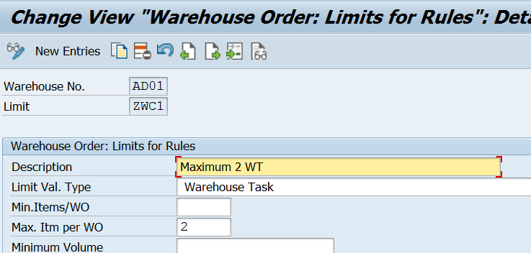

Slide 24
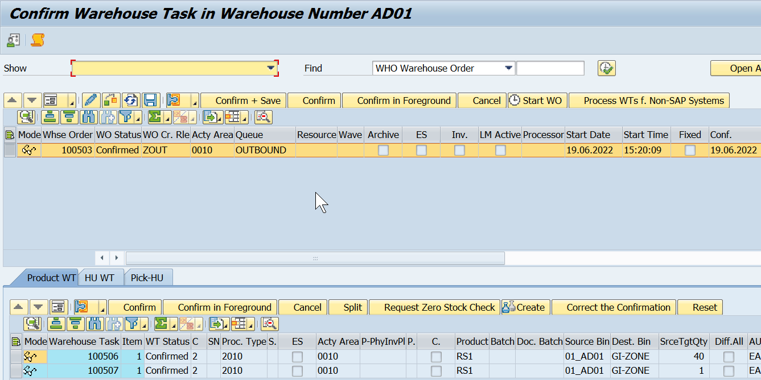

Slide 25


End of Session 08
www.anubhavtrainings.com

Slide 26

FEEL FREE TO ASK QUESTIONS

Slide 27

Feedback

Slide 28
THANK
YOU

Slide 29
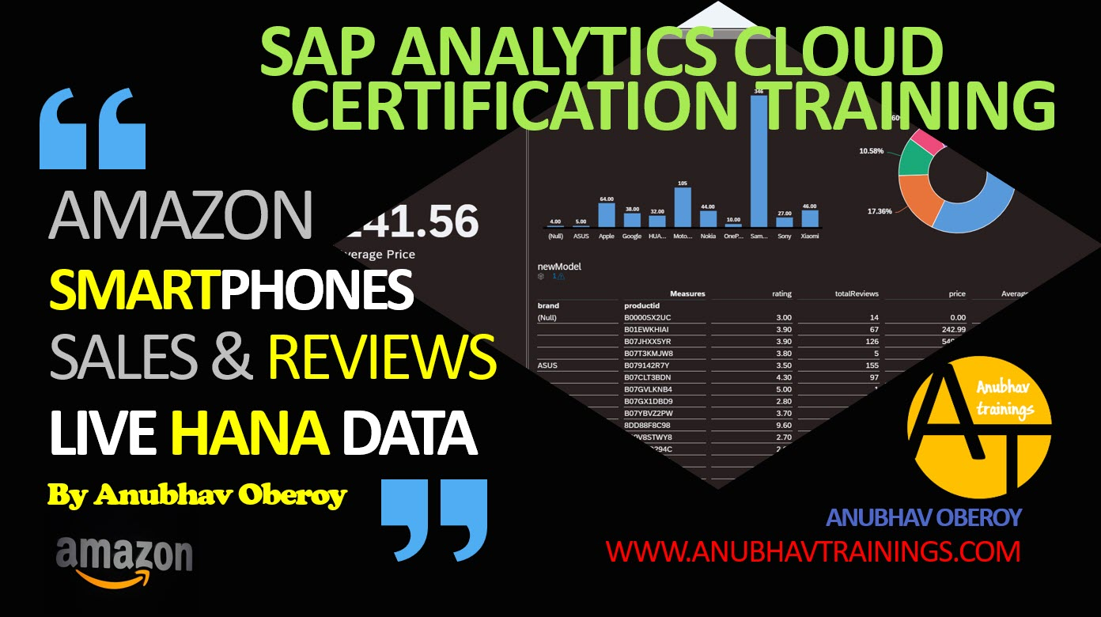
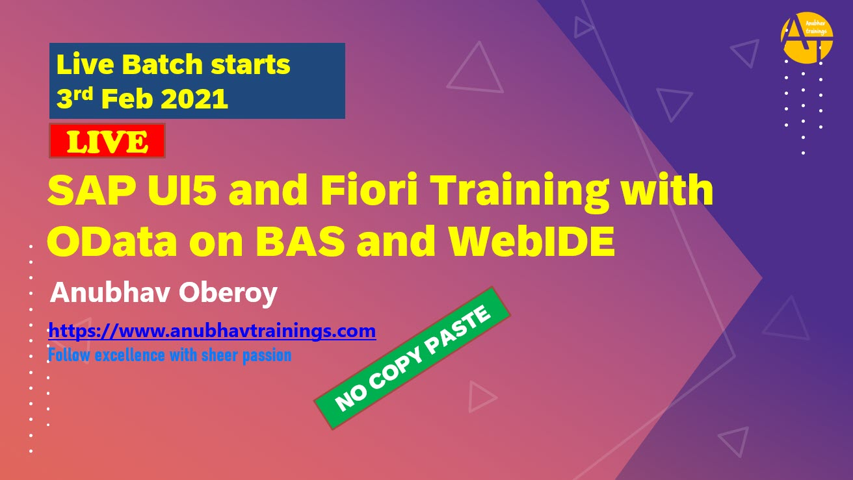

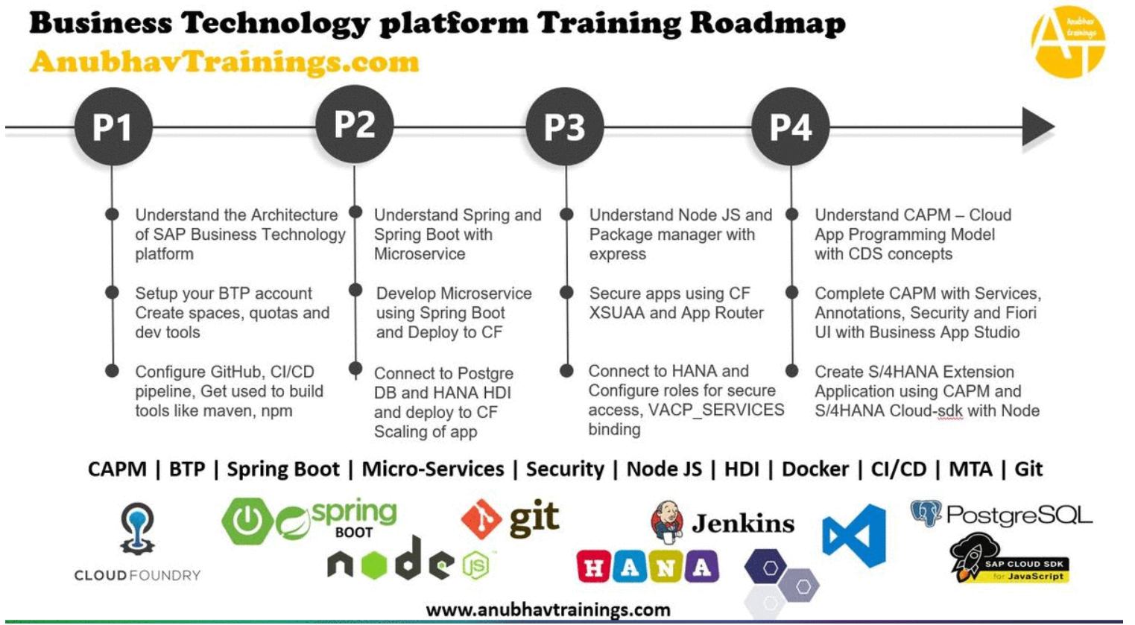
More from AnubhavTrainings.com

Slide 30






We’re committed to empower you to be
#FutureReady
through powerful training solutions.
We build the workforce of the future.
250+
Corporate Clients
30,000+
Learners Trained
25000+
Learners Placed
FREE WEBINARS
Sign up for free webinars with industry experts every fortnight!
Enroll Now!

Slide 31
FREE WEBINARS
Sign up for free webinars with industry experts every fortnight!
Contact us today!
www.anubhavtrainings.com

